Slide 1
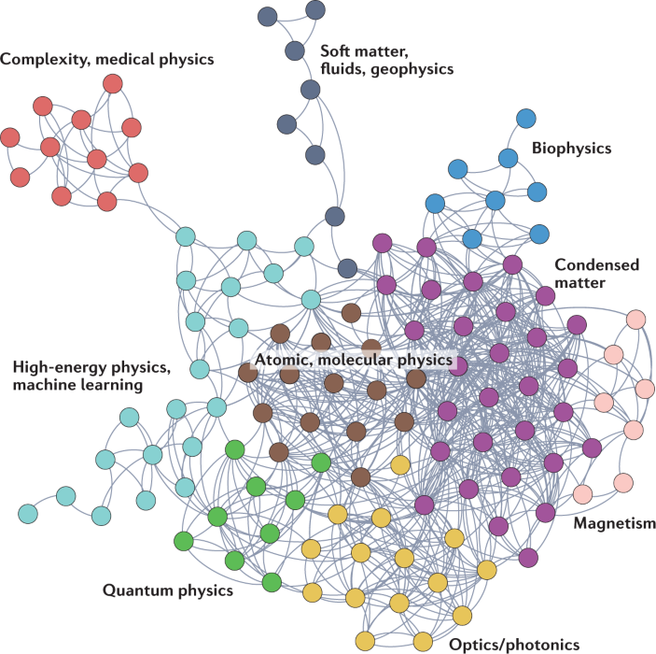
xxx

Slide 2
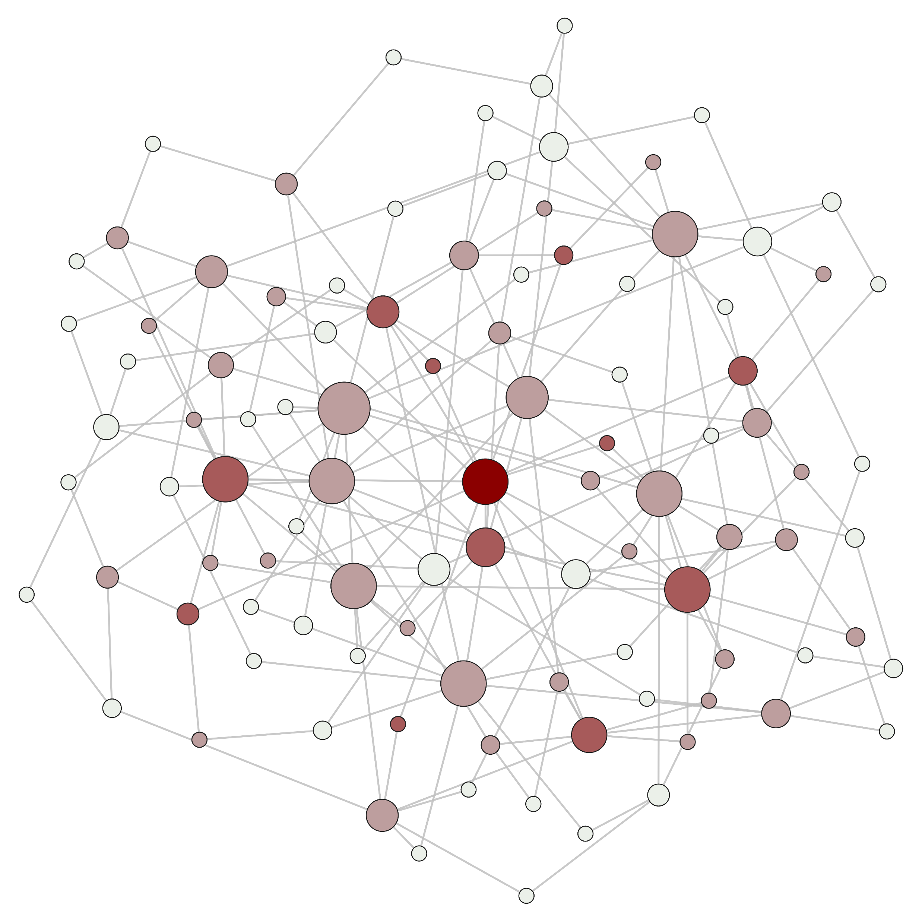
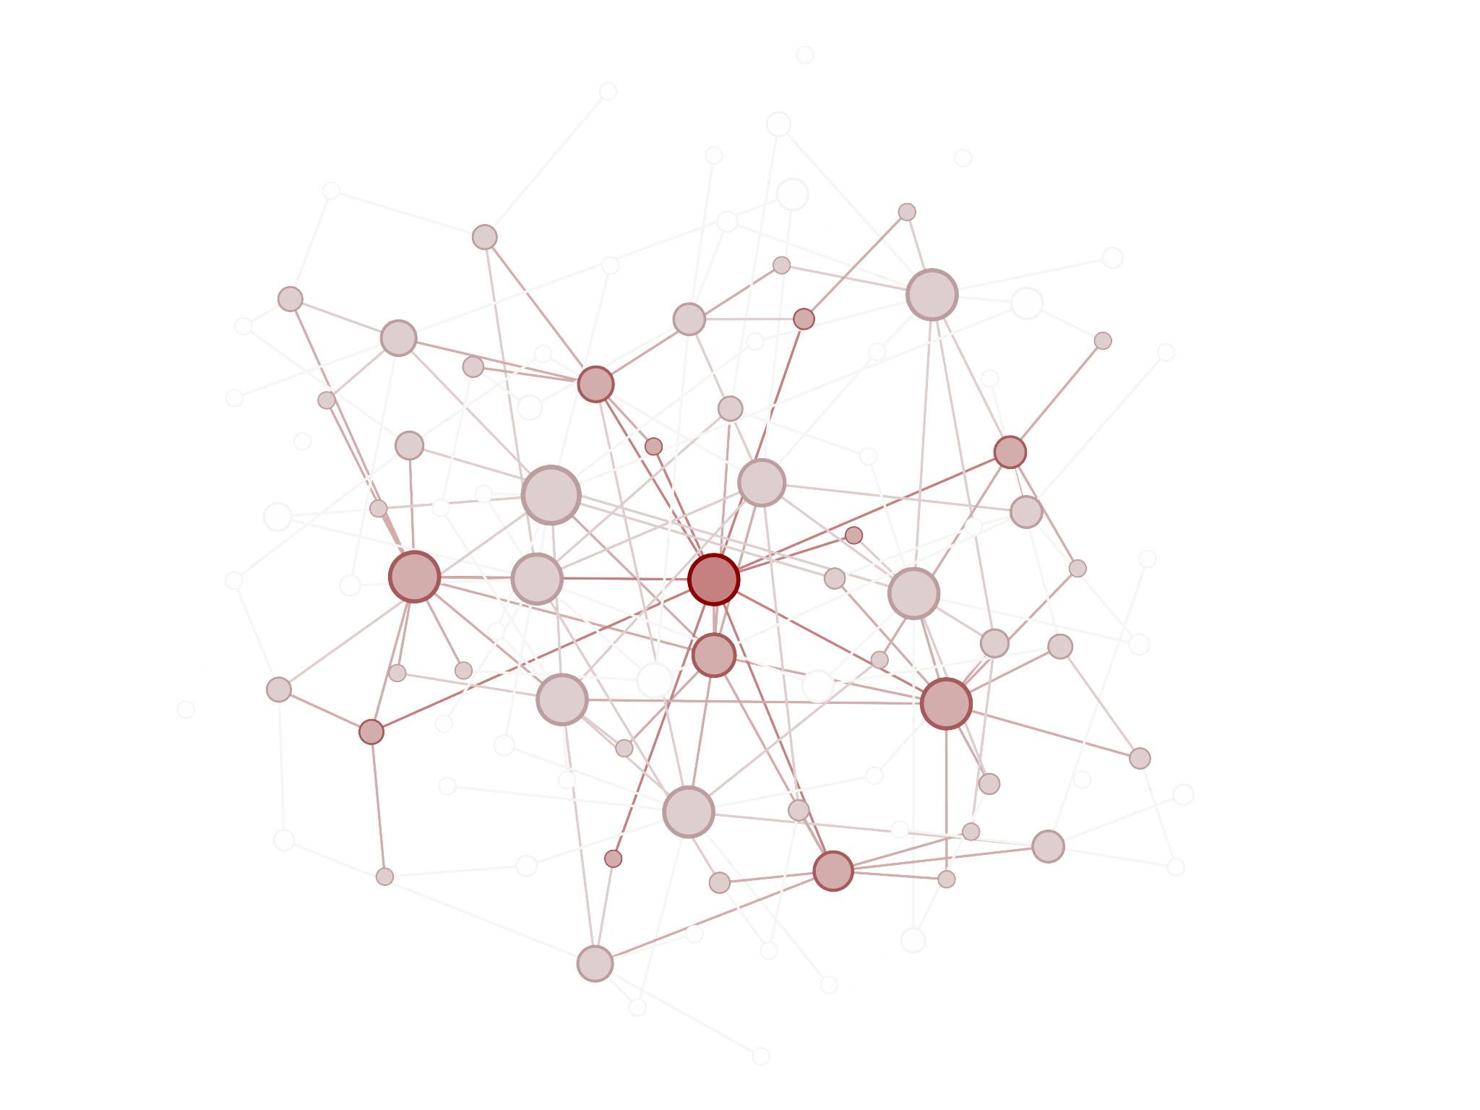
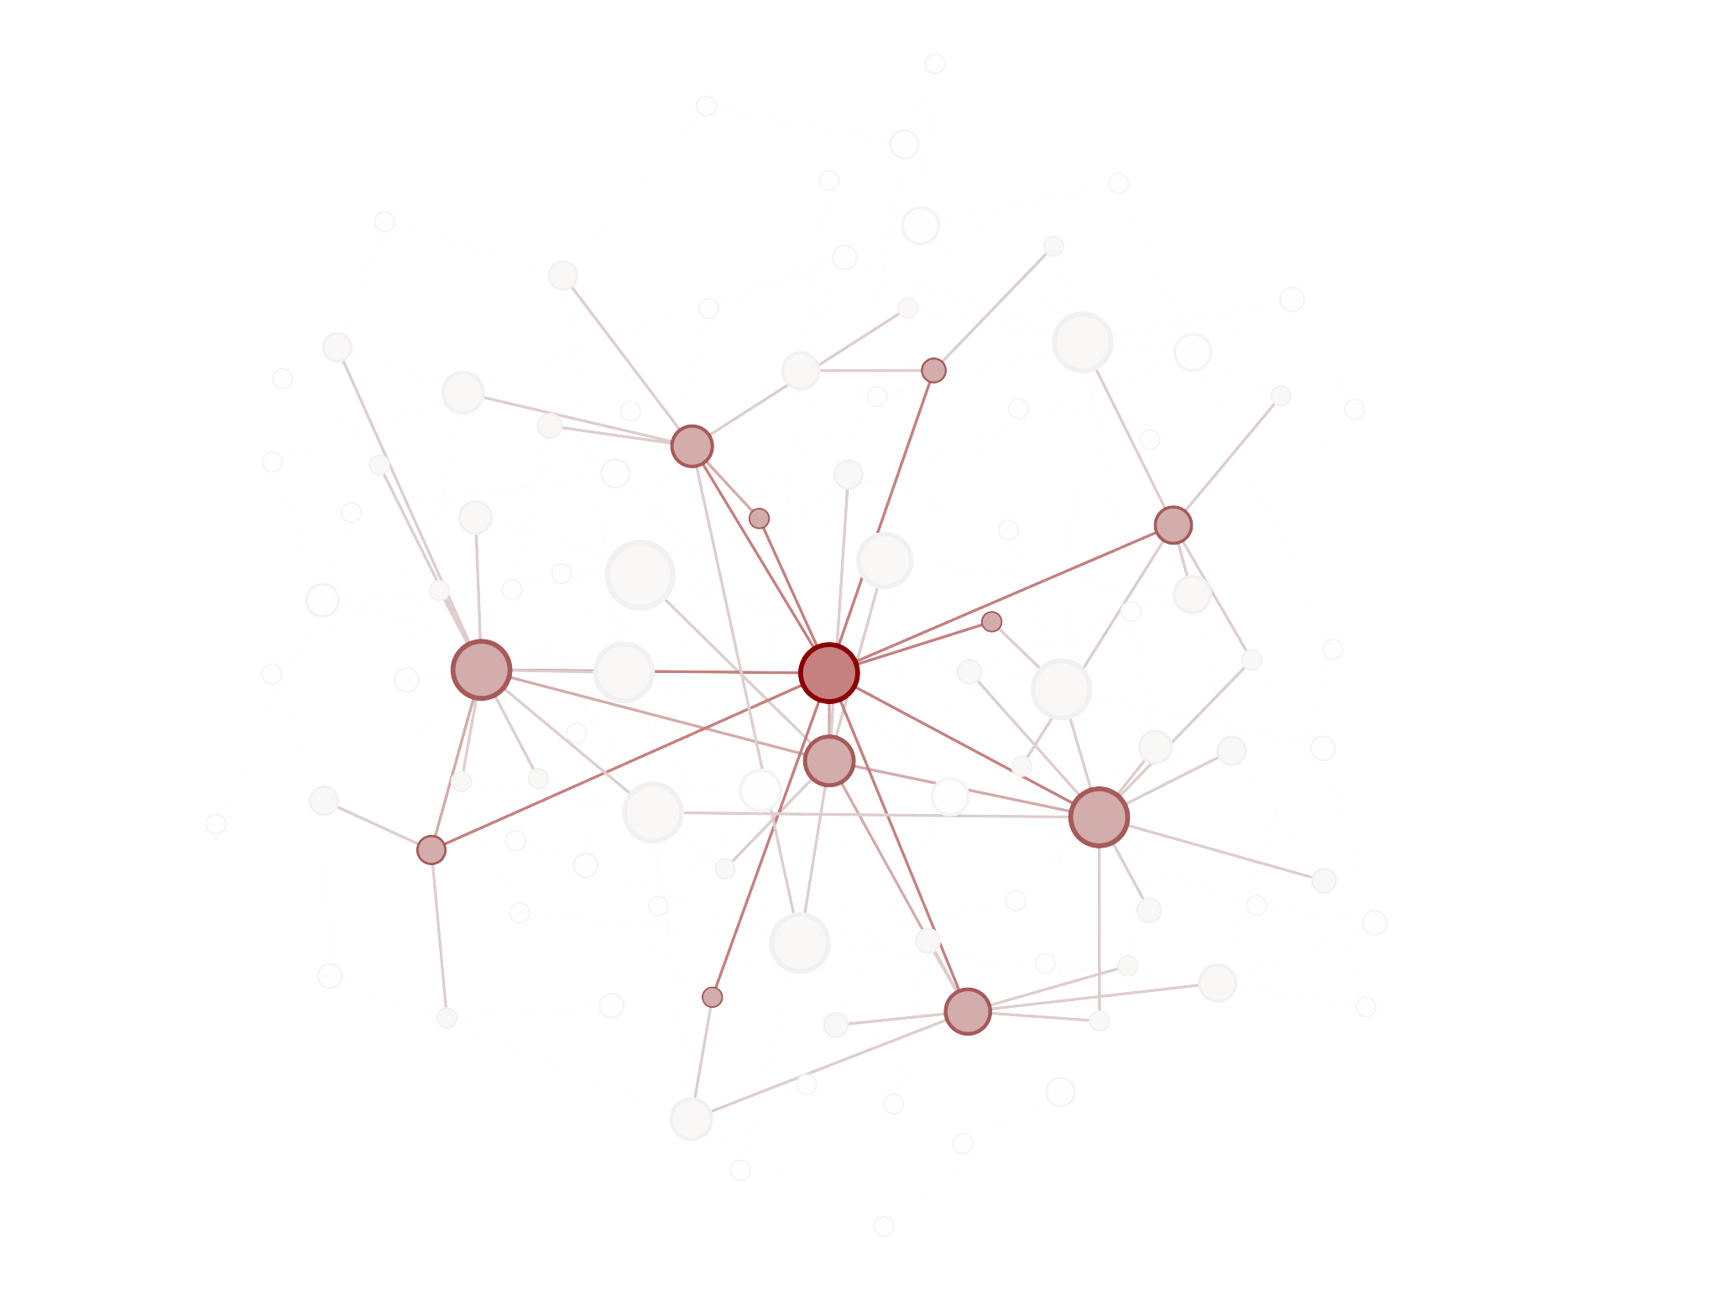


Slide 3
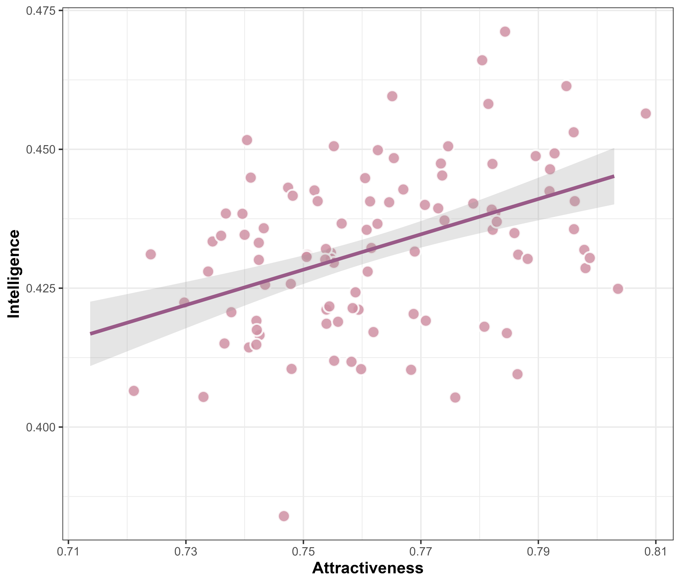
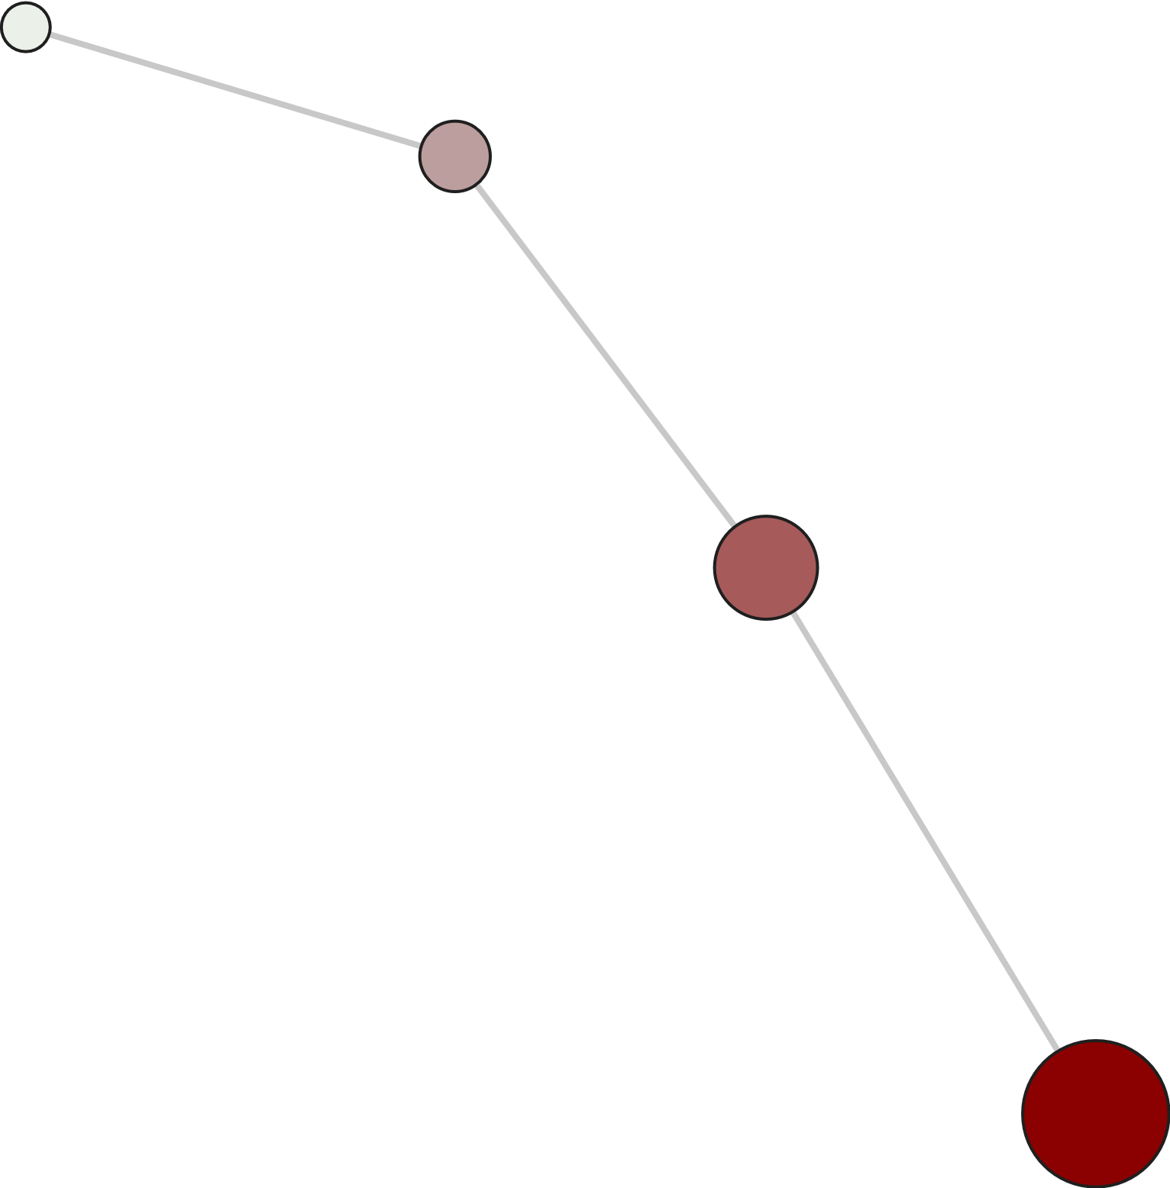

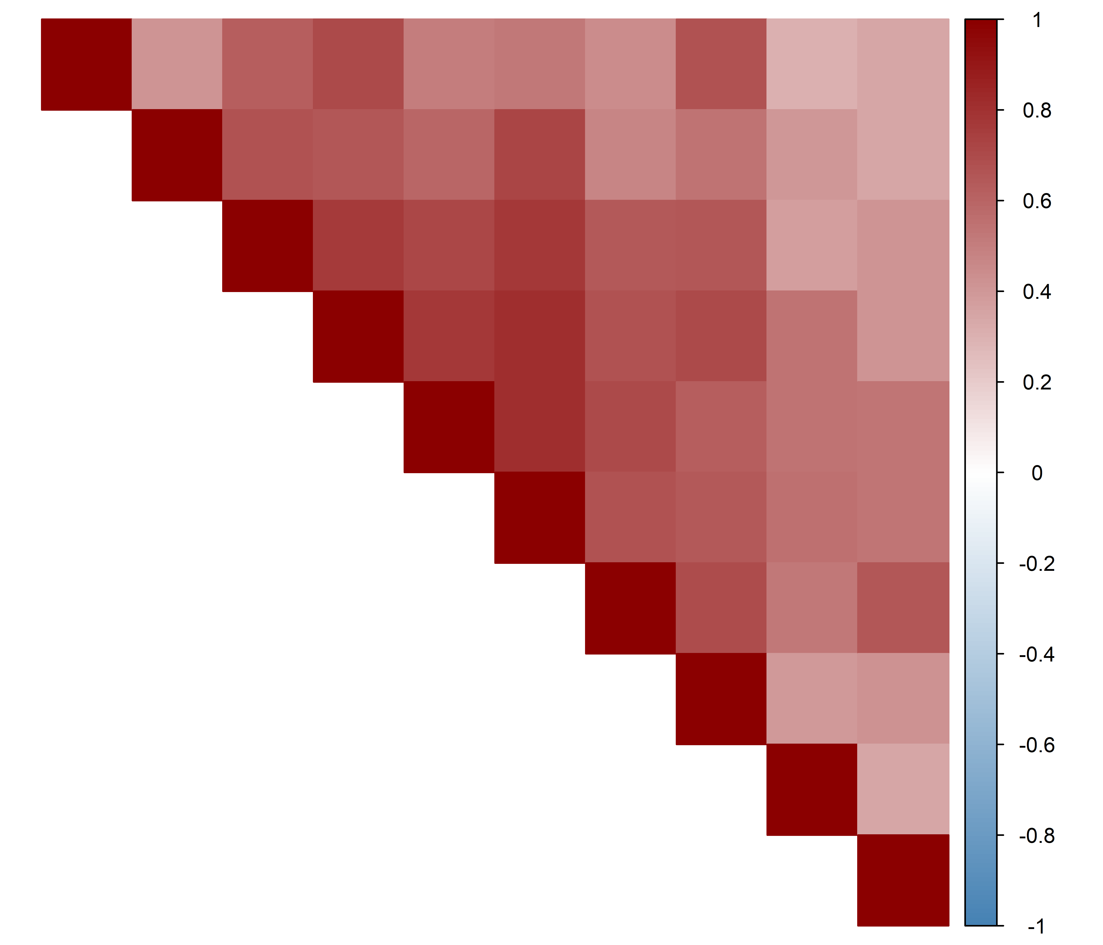
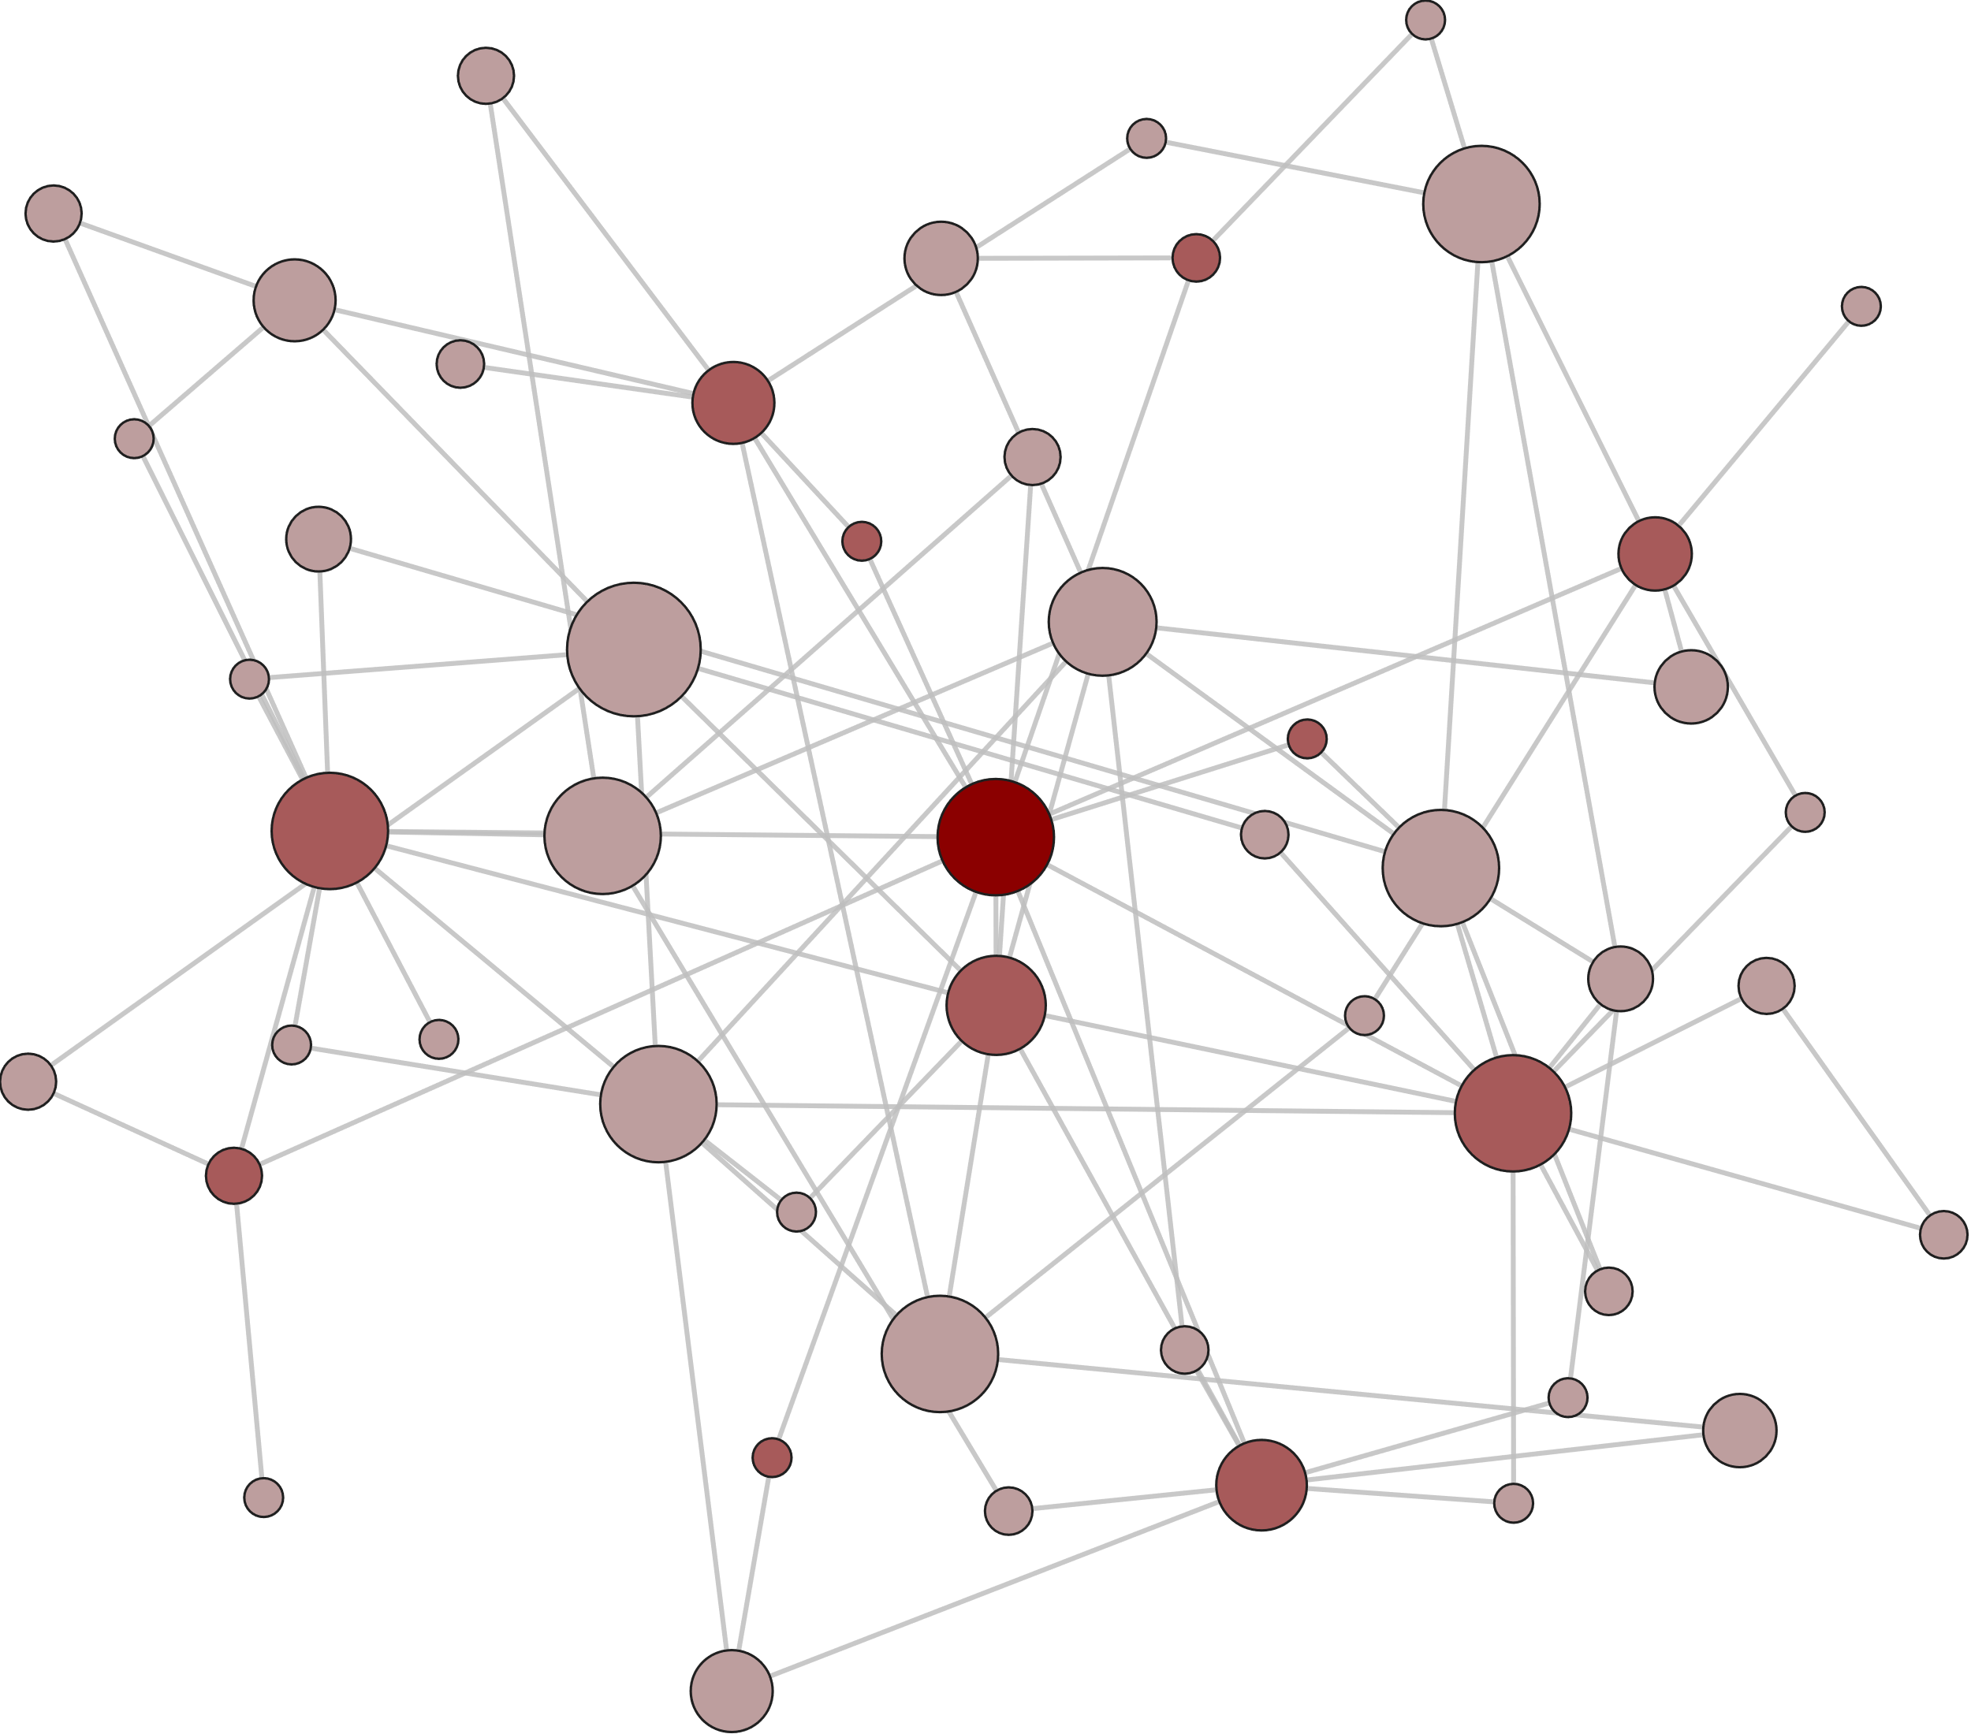
a
b
c
The beauty-is-good effect
Intelligence
Attractiveness
…
d
One-hop Neighborhood
Two-hop Neighborhood
e
Psychological Dimensions
Dimension

Slide 4
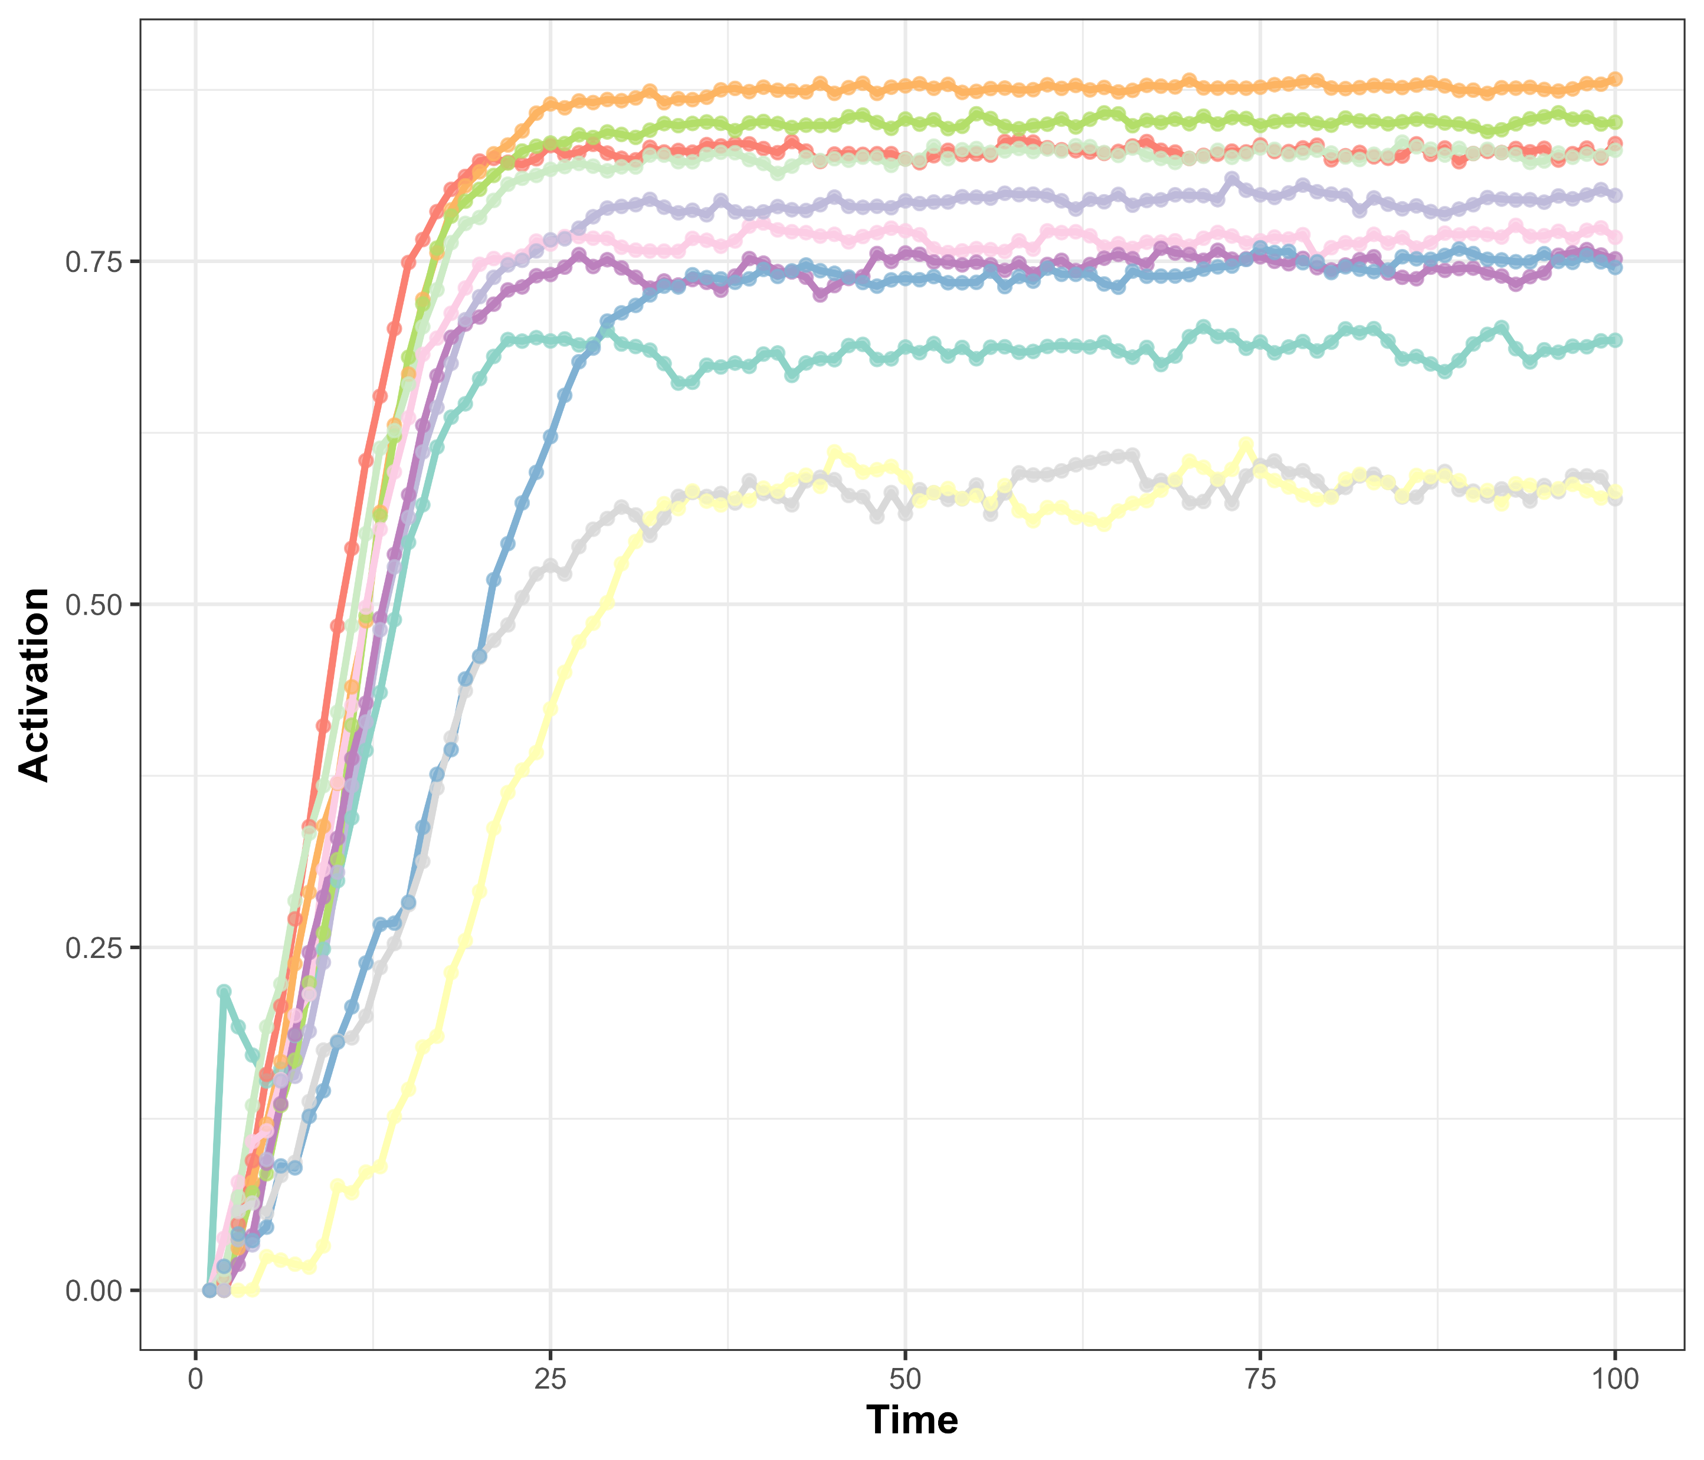

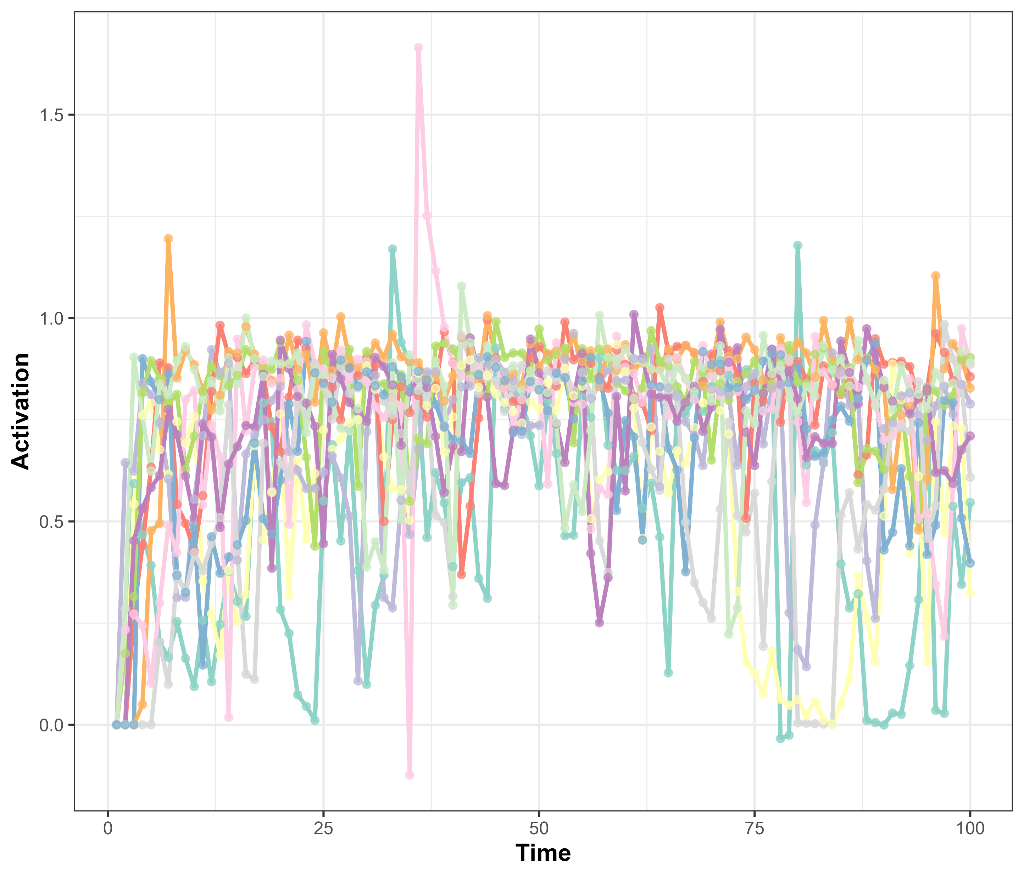

a
b
c
d

Slide 5
The beauty-is-good effect
Intelligence
Attractiveness
…
One-hop Neighborhood
Two-hop Neighborhood
Psychological Dimensions
Dimension

Slide 6
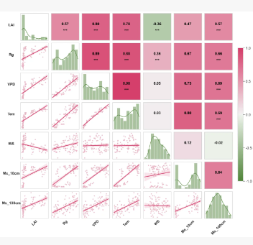
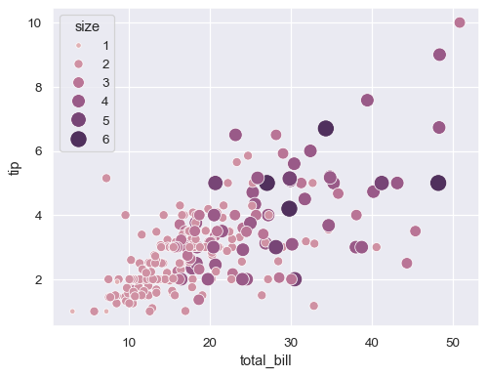
xxx

